Slide 1


FYP
GlucoPredict: AI- Powered Diabetes Predictor
Muhammad Moiez Siddiqui (2270-2021)
Muhammad Hassan bin Sabih (2203-2021)
Supervisor: Dr. Khurram Iqbal
Department of Computing, FEST
Hamdard University

Slide 2
Summary
Problem Statement
Objective
FYP Scope
Our methodology
Our Project Plan (Time lines)
Budget / Costing (if any)
FYP Deliverables
Literature Review
Demo of 100% of Work
Experimental Evaluations & Results
Test Plan
Test Cases
References

Slide 3
Problem Statement
"Empowering With Insights For A Healthier Future”
GlucoPredict automates the prediction of the humans that whether they are diagnosed with Diabetes or not.

Slide 4
Objective
Early Diabetes Prediction Utilize advanced AI and machine learning algorithms to predict the risk of diabetes in individuals. Enable early detection to prevent the onset of diabetes and manage health proactively.
Personalized Health Recommendations
Provide personalized health recommendations based on individual health data, lifestyle, and genetic factors. Help users make informed decisions about their health and lifestyle to reduce diabetes risk.
Accessible Health Monitoring
Develop a user-friendly platform accessible via mobile app. Ensure that users can easily input their health data and receive timely risk assessments and recommendations.

Slide 5
FYP Scope
1. Project Scope and Target Users: GlucoPredict aims to create an AI system to predict diabetes risk, targeting at-risk individuals, healthcare providers, and researchers, assuming users provide accurate health data and have access to the necessary technology.
2. Limitations and Challenges: The system does not replace medical diagnoses or address rare diabetes forms and may face accuracy issues with incomplete data.
3. Functional Goals and Expansion: The project offers AI-driven risk predictions and personalized recommendations via mobile and web apps, compatible with electronic health records, initially focusing on regions with high diabetes prevalence and strong digital infrastructure, with plans for future expansion.

Slide 6
Our Methodology
The Agile methodology, specifically the Scrum framework, is an appropriate software development approach for the GlucoPredict project.
Why Agile?
We adopted Agile because it is well-suited for projects that require flexibility, iterative development, and continuous feedback. The team can divide the work into smaller, manageable tasks and prioritize them based on their importance and value. As the project scope involves multiple components, including data collection, preprocessing, model development, system integration, user interface design, testing, and deployment, different parts of the system can be developed in parallel.

Slide 7
Our Project Plan
Phase Name | Description | Start Date | End Date | Duration | Responsible Person
Project Initiation | Proposal drafting, problem identification, supervisor approval | 16/08/24 | 20/8/24 | 4 Days | Hassan bin Sabih
Requirement Gathering and Analysis | Collect and finalize functional and non – functional requirements | 22/8/24 | 30/8/24 | 8 Days | Hassan bin Sabih
System Architecture & Design | Design system architecture, data flow diagrams, and database schema | 2/9/24 | 9/9/24 | 7 Days | Hassan bin Sabih
ML Model Development | Data preprocessing, model selection, training and evaluation | 10/9/24 | 4/10/24 | 27 Days | Moiez Siddiqui
Integration & API Development | Connect app with backend APIs, Firebase, and prediction server | 1/1/25 | 30/1/25 | 30 Days | Moiez Siddiqui
Testing & Debugging | Perform unit, integration, system, and UAT tests | 1/2/25 | 15/2/25 | 15 Days | Moiez Siddiqui
Deployment Preparation | Finalize app, hosting, and database setup for production | 1/3/25 | 20/3/25 | 20 Days | Moiez Siddiqui
Document Finalization | Prepare final FYP report, coding standards, policies, and manuals | 1/7/25 | 2/7/25 | 1 Day | Hassan bin Sabih
Final Presentation & Submission | Prepare slides, project demonstration, and final submission | 2/7/25 | 3/7/25 | 1 Day | Hassan bin Sabih

Slide 8
Budget / Costing
Cloud Hosting (AWS) = 25,000 PKR
Firebase Services = 2,000 PKR
Laptop = 80,000 PKR
Mobile Devices = 45,000 PKR
Internet + Miscellaneous = 7,000 PKR
Estimated Total Project Cost = 1,59,000

Slide 9
FYP Deliverables
Software Test Plan/ Test Report
Complete software demo
Project Report – II
CD/USB Comprising all documents, source code, exe, and other material
Project Poster with a wooden frame and panaflex placed on it
Requirement signoff sheet

Slide 10
Literature Review
The use of AI technology has catalyzed a great leap in the fields of predicting and managing diseases in medicine. Many AI based applications are designed to assist in the diagnosis of various health issues, as well as aid in personal health optimization and delivering better services to patients in general. Thus, predictive tools specifically designed for early diagnosis of diabetes are yet to be developed. This literature review discusses the available tools, compares them by their approaches, and presents the contribution of GlucoPredict in predicting and controlling diabetes risk.

Slide 11
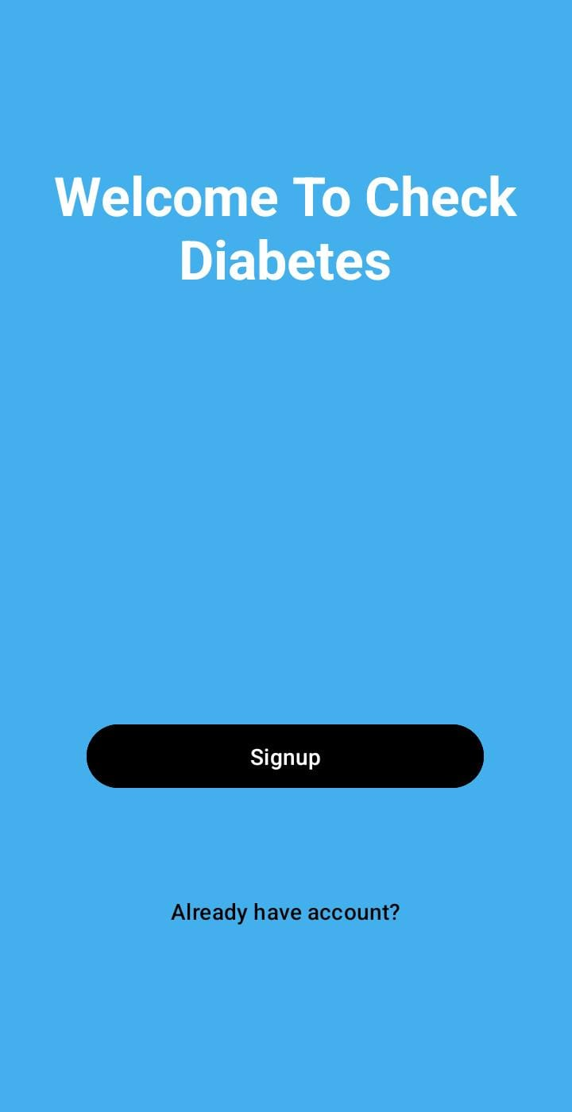
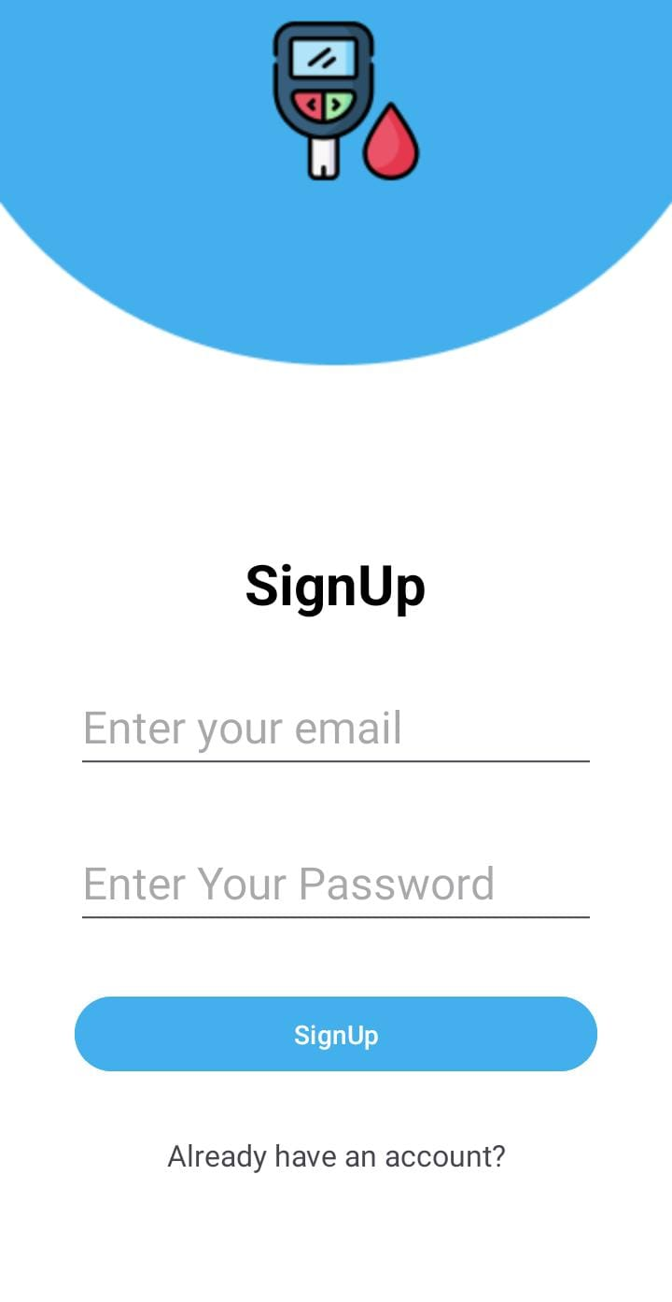
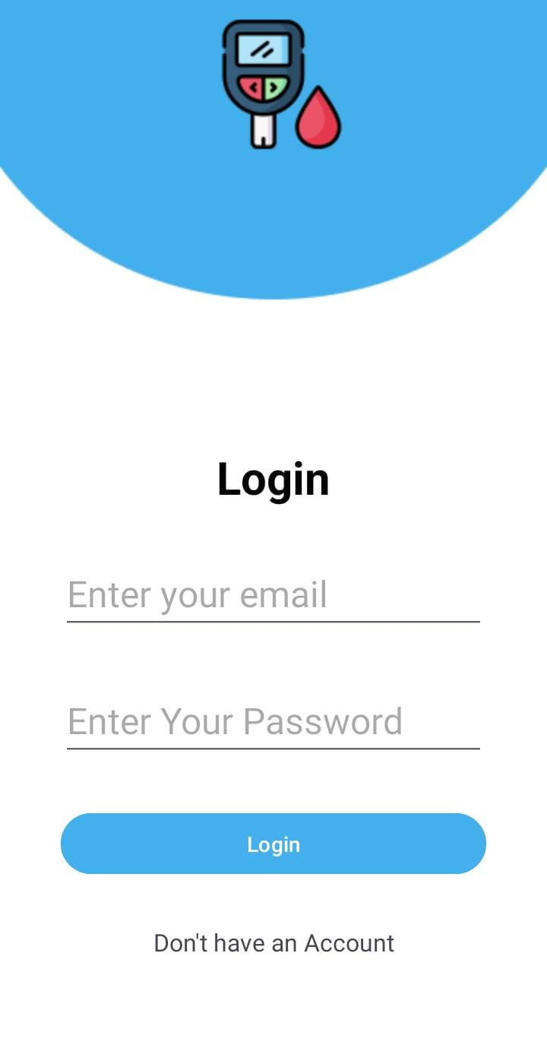
Demo of 100% of Work

Slide 12
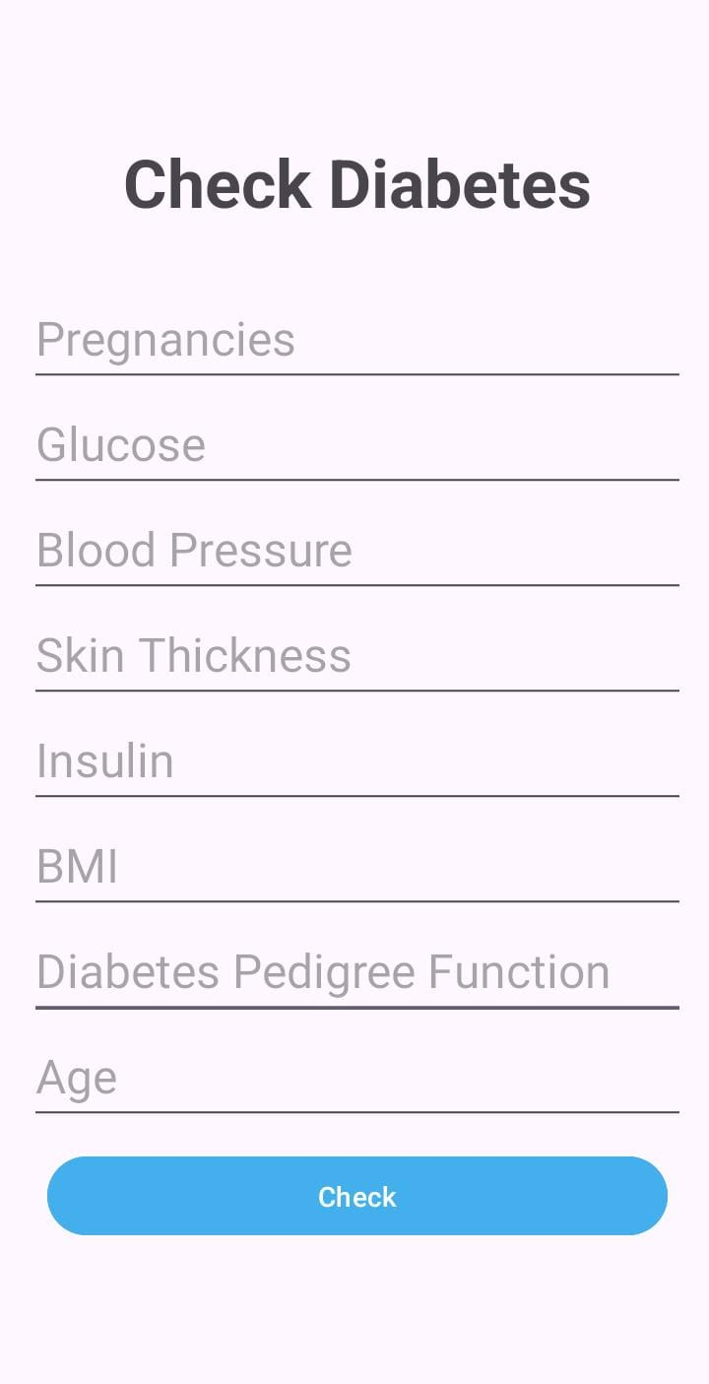
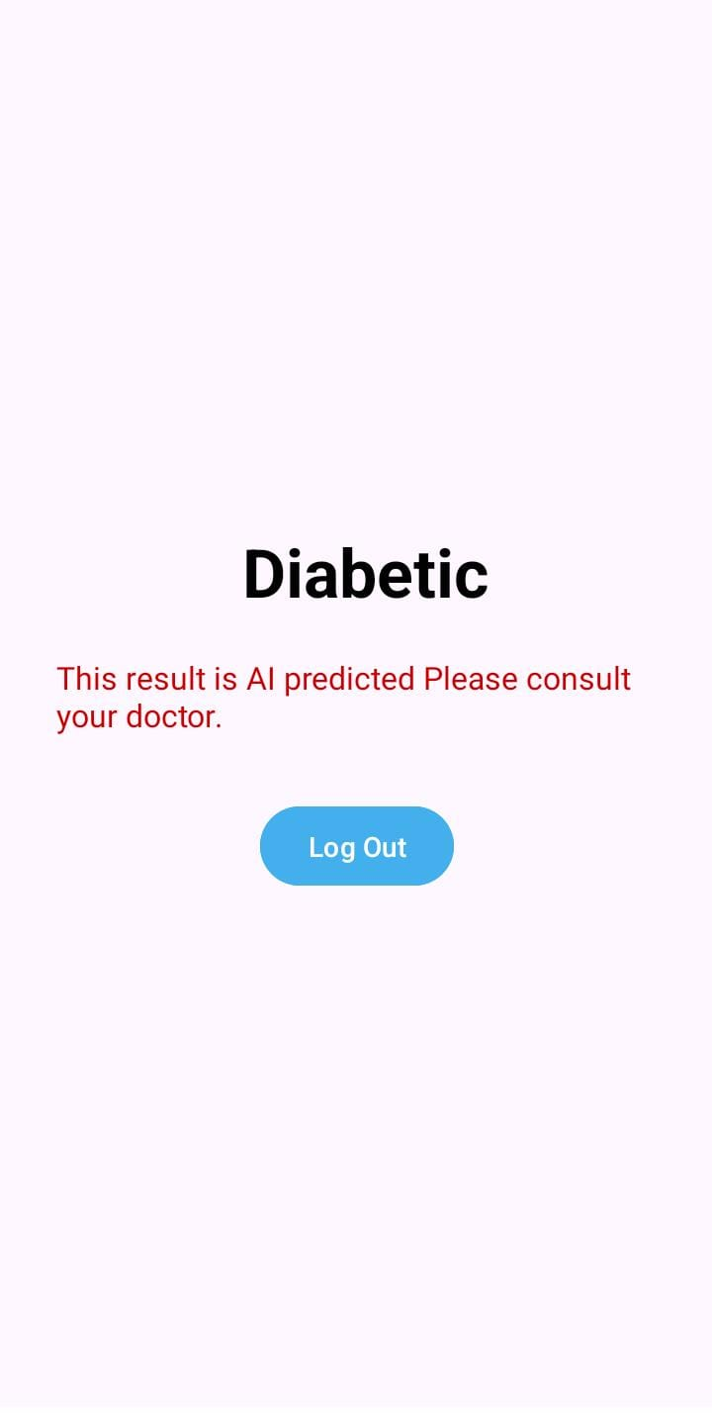

Slide 13
Experimental Evaluations & Results
Evaluation Testbed:
ML Model: Trained using TensorFlow & Scikit-learn
Test Devices: Android smartphones (Android 11+)
Backend Hosting: AWS EC2 virtual machine
Database: Firebase & AWS DynamoDB
Tools Used: Postman, Android Emulator, Jupyter Notebook
Test Users: 10 simulated patient profiles
2. Key Performance Results:
Metric | Results
Prediction Accuracy | 87%
Average Response Time | 1 minute
Uptime Availability | 99%
User Satisfaction | Positive feedback from test users

Slide 14
Test Plan
Software Test Plan:
S. No | Description | Test Engineer | Start Date | End Date
1 | Sign Up Screen | Hassan | 02-June-2025 | 03-June-2021
2 | Sign In Screen | Hassan | 04-June-2025 | 07-June-2025
3 | Health Input Screen | Moiez | 08-June-2025 | 11-June-2025
4 | Result Screen | Moiez | 12-June-2025 | 14-June-2025
5 | Test-1 | Moiez | 14-June-2025 | 14-June-2025
6 | Test-2 | Hassan | 16-June-2025 | 16-June-2025
7 | Test-3 | Hassan | 17-June-2025 | 17June-2025

Slide 15
Test Case
Test Case 1:
Project Name: GlucoPredict
Iteration No: 1
Module Name: Sign Up Screen
Date: 14-June-2025
Test Case ID: TC – 1
Test Engineer: Hassan
Test Case Description: Detailed testing of this module
S. No | Steps | Input Data | Expected Result | Actual Result | Pass/ Fail
1.1 | Open the Sign-Up Screen | - | Sign Up form displays correctly | It did display as expected | Pass
1.2 | Enter email and password | Valid credentials | Input fields and accept data | Data entered successfully | Pass

Slide 16
Test Case 2:
Project Name: GlucoPredict
Iteration No: 1
Module Name: Log In Screen
Date: 16-June-2025
Test Case ID: TC – 2
Test Engineer: Hassan
Test Case Description: Detailed testing of this module
S. No | Steps | Input Data | Expected Result | Actual Result | Pass/ Fail
2.1 | Open the Log In Screen | - | Log In form displays correctly | It did display as expected | Pass
2.2 | Enter email and password | Valid credentials | Input fields and accept data | Data entered successfully | Pass
2.3 | The GlucoPredict Dashboard appears | - | Dashboard displays correctly | It did display as expected | Pass

Slide 17
Test Case 3:
Project Name: GlucoPredict
Iteration No: 1
Module Name: Input Health Data Screen
Date: 17-June-2025
Test Case ID: TC – 3
Test Engineer: Moiez
Test Case Description: Detailed testing of this module
S. No | Steps | Input Data | Expected Result | Actual Result | Pass/ Fail
3.1 | Open the Data Entering Screen | - | Dashboard displays correctly | It did display as expected | Pass
2.2 | Enter data as per the required fields | Valid credentials | Input fields and accept data | Data entered successfully | Pass
2.3 | The result screen is displayed | - | Dashboard displays correctly | It did display as expected | Pass

Slide 18
Reference
World Health Organization, Global Report on Diabetes, Geneva: WHO Press, 2016. https://www.who.int/publications/i/item/9789241565257
American Diabetes Association, "Classification and Diagnosis of Diabetes," Diabetes Care, vol. 46, no. 1, pp. S19–S40, 2023. doi:10.2337/dc23-S002
L. Breiman, "Random Forests," Machine Learning, vol. 45, no. 1, pp. 5-32, 2001. doi:10.1023/A:1010933404324
S. Hochreiter and J. Schmidhuber, "Long Short-Term Memory," Neural Computation, vol. 9, no. 8, pp. 1735–1780, 1997. doi:10.1162/neco.1997.9.8.1735
TensorFlow Developers, TensorFlow: An end-to-end open source machine learning platform, [Online]. Available: https://www.tensorflow.org
Scikit-learn Developers, Scikit-learn: Machine Learning in Python, [Online]. Available: https://scikit-learn.org
Firebase Documentation, "Firebase Authentication," [Online]. Available: https://firebase.google.com/docs/auth
Amazon Web Services (AWS), "AWS Cloud Computing Services," [Online]. Available: https://aws.amazon.com
Google Cloud Platform (GCP), "Google Cloud Services," [Online]. Available: https://cloud.google.com
M. Esteva et al., "A guide to deep learning in healthcare," Nature Medicine, vol. 25, no. 1, pp. 24–29, 2019. doi:10.1038/s41591-018-0316-z

